Slide 1

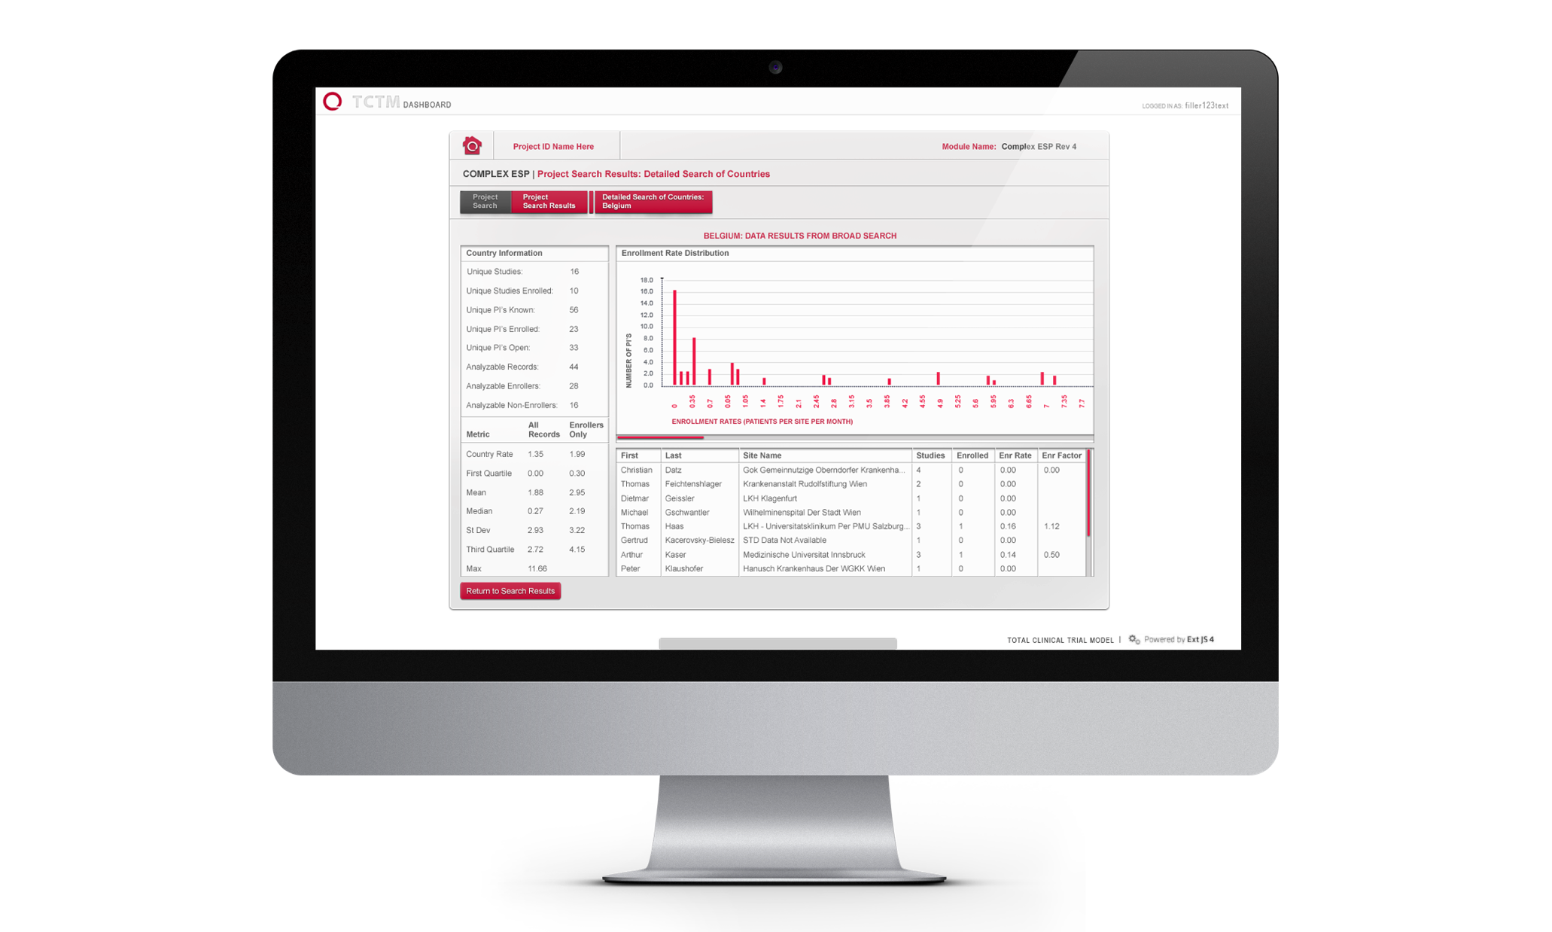
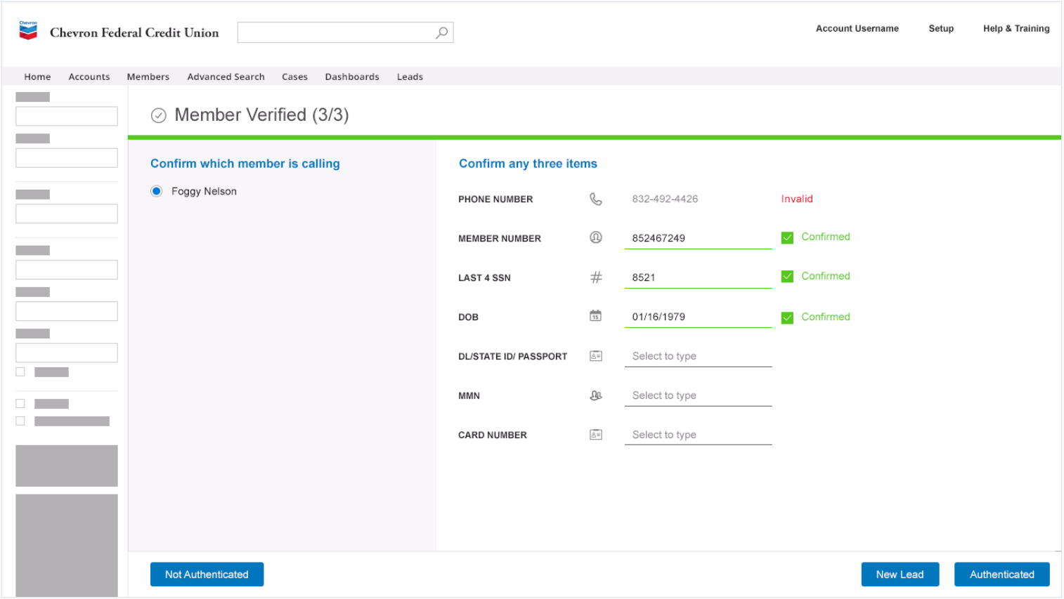
Chevron Credit Union
Goal
Affirma partnered with Chevron Federal Credit Union to modernize their messaging portal used by customer support staff. This involved an entire rebuild of outdated Salesforce environments and integrations with multiple complex systems such as their banking platform and telephony system.
Deliverables
Salesforce Community Cloud messaging portal with customized look and feel
Single Sign-On integration to their Online Banking platform
Conversion of Sales Cloud & Service Cloud environment from their Classic solutions to the Lightning Experience.
Full integration between CFCU’s CTI/Telephony infrastructure and Service Cloud to provide an automated scorecard system that authenticates members over the phone before they reach call center representatives.

Slide 2
Chevron Credit Union – Salesforce Managed Service
Project-Based Work
Affirma initially partnered with Chevron FCU to implement Salesforce Community Cloud and create a secure messaging portal with customized look and feel, & Single Sign-On integration to their Online Banking platform.
Affirma performed the entire conversion of CFCU’s Sales Cloud & Service Cloud environment from their Classic solutions to the Lightning Experience.
Affirma developed a full integration between CFCU’s CTI/Telephony infrastructure and Service Cloud to provide an automated scorecard system that authenticates members over the phone before they reach call center representatives.
Ongoing Managed Service Partnership
8+ full-time Salesforce Developers
Full Project Management & Development Leadership
On-Site Salesforce Business Analyst & Administrator
Integrated project management processes and platforms
Full augmentation of Application Architecture Design, Development Operations and support for Salesforce & integrated platforms across multiple client business groups.

Slide 3
Chevron Federal Credit Union - Salesforce Lightning
Chevron Federal Credit Union
Affirma began working with CFCU when their Salesforce implementation was in already in flight. Our team began with small projects to tackle immediate pain points, and continued with larger projects until we implemented a managed service to augment the majority of their Dev Ops. Affirma’s Managed Service team managed CFCU’s complex migration from Classic to Lightning including:
Client Testimonial on the Migration
I wanted to take the time to let you know about the fantastic support we received in helping us migrate to Salesforce Lightning. Although we actually always receive excellent support from the Affirma team for our Salesforce platform, the team went out of their way to help us in every way possible. As expected, we came across multiple issues and questions due to our design, configuration, development, testing, migration, and just our own inexperience with Lightning. The team stepped up and gave us the expertise and support we needed to make this upgrade happen successfully. I would say in every case, even when we asked for something a bit out of the ordinary (as clients always do), we always received fast, professional help and advice. I do not believe we could have received any better support from anyone.
The upgrade to Lightning was very successful, with only minor issues and not one show-stopper. Our planned week-long “Hot Line” for user issues was turned off after just one day due to lack of issues. The folks who we mainly dealt with were Katherine Gluth, Krunal Sangani, Saumil Shah, and Amit Wadhwa, although I believe there were a few other folks that helped out also. I hope they all get the recognition they deserve. Although the best I can do is say thank you, it is a very big thank you. I look forward to continue working with the Affirma team.
All the best,
Lonny H. Nathanson
CRM Product Manager | Application Services
Chevron Federal Credit Union
Salesforce Inventory
Lightning (Aura) Components | 92
Visualforce Pages | 248
Visualforce Components | 60
Test Classes | 417
Apex Classes | 631
Triggers | 45
Workflow Rules | 117
Process Builders | 17

